Slide 1
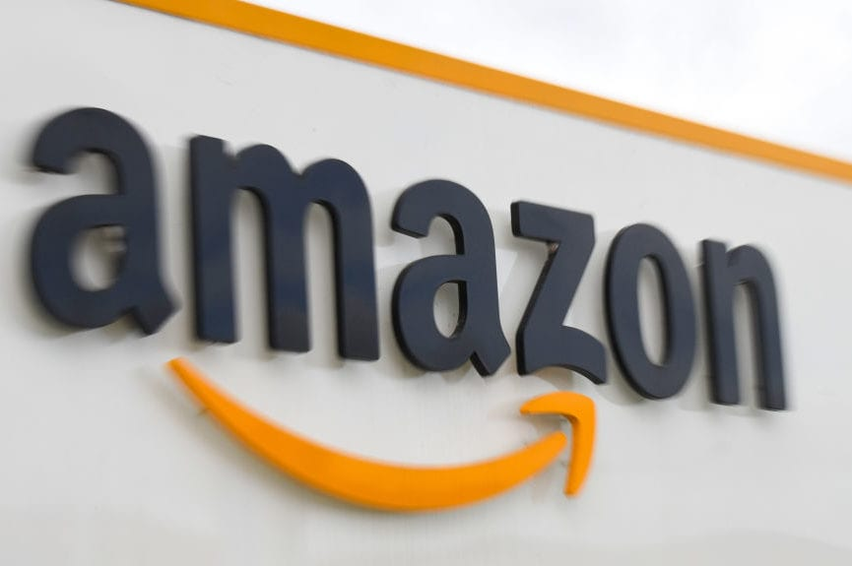
Amazon Data Analysis
By Anil r

Slide 2
Problem Statement
You are working as a business analyst at Amazon, a company currently performing well. The stakeholders wish to maintain this level of performance and seek improvement. For this purpose, they want to devise new strategies.
You are part of a team exploring new ways to benefit customers, such as offering more discounts and Prime membership perks. Could you suggest additional methods to identify and reward customers and enhance their shopping experience?

Slide 3
Objective
Identifying Unique Customers Over the Year
Evaluating Product Revenue Breakdown
Analyzing the Impact of Product Ratings on Sales
Identifying Localities with Revenue Distribution
Identifying Popular Products, Categories, and Subcategories
Evaluating the Waiting Period Based on Delivery Type
Analyzing the Relationship Between Shipping Fees and Product Categories
Proposed Measures to Improve Sales
Reports

Slide 4
approach
Data Cleaning: Ensure data quality by removing inconsistencies, errors, and missing values to prepare for analysis.
Key Metrics Identification: Determine metrics such as sales revenue, orders placed, and product ratings to evaluate operational impact.
Geographical Sales Analysis: Utilize map visualizations to analyze revenue distribution, identifying high and low-performing regions for targeted strategies.
Product Marketing Focus: Identify underperforming products and develop targeted marketing campaigns to increase visibility and drive sales.
Loyalty Program Development: Design and implement a tiered customer loyalty program with personalized rewards to enhance customer retention and drive repeat purchases.
Utilize Power BI for comprehensive data exploration and visualization to gain insights and inform decision-making.

Slide 5
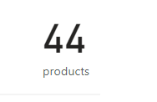
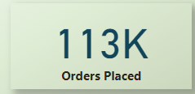
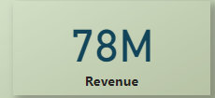
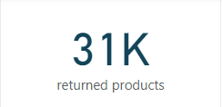
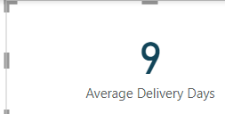
Key Metrics
No of products
Total orders placed
Total Revenue
Orders returned
Average delivery days for delivered orders

Slide 6
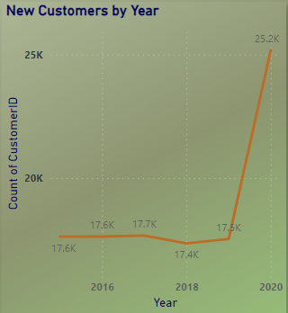
Identifying Unique Customers Over the Year
INSIGHTS
From this analysis, it's evident that there has been a general trend of growth in the number of unique customers over the years, with fluctuations in some years. However, the most notable increase occurred in 2020, indicating a substantial expansion of the customer base compared to previous years.

Slide 7
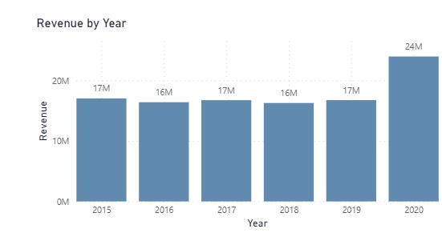
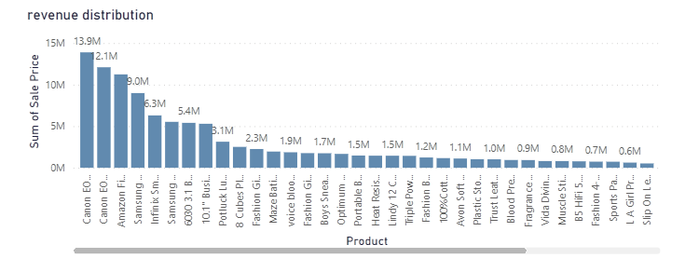
Revenue distribution analysis
With revenue distribution, we can understand which product contributed more to the revenue and also in which year revenue generated more.
INSIGHTS
Revenue generated in the year 2020 is more compared to previous years.
Top revenue generated product is Canon EOS 600D 18MP DSLR Camera- Black with 13.9M sales.

Slide 8
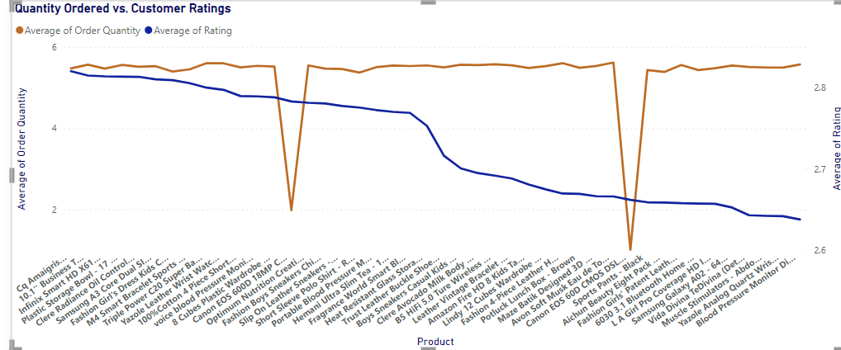
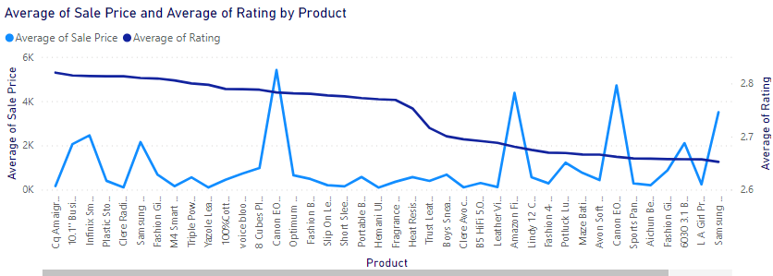
Analyzing the Impact of Product Ratings on Sales
INSIGHTS
Product ratings don't correlate with sales. High ratings don't guarantee high sales, and low ratings don't always mean low sales. Despite expectations, there's no consistent link between ratings and sales. High-rated products may not sell more, and low-rated ones can still have significant sales.

Slide 9
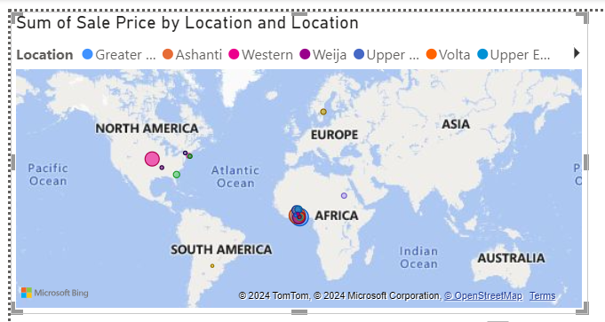
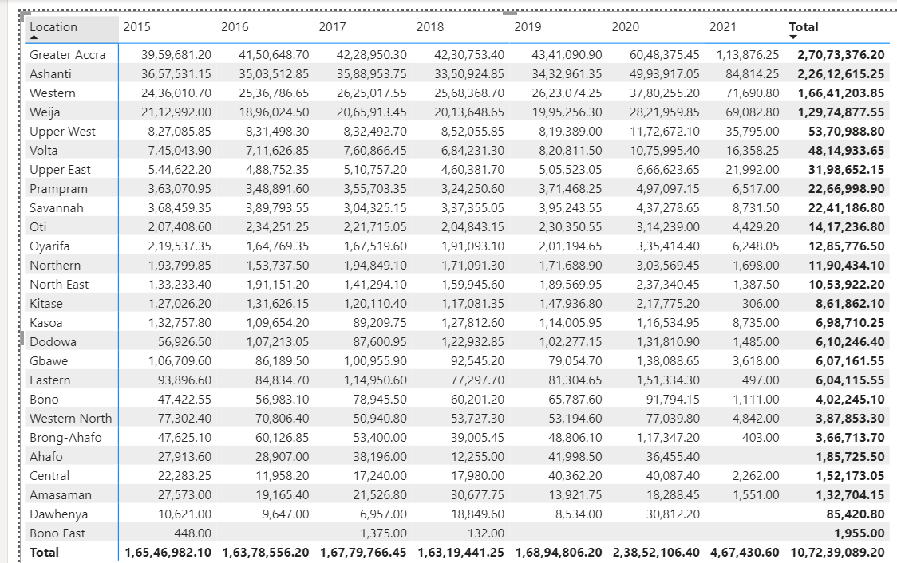
Identifying Localities with Revenue Distribution
INSIGHTS
Top 5 Locations by High Revenue
Greater Accra
Ashanti
Western
Weija
Upper West
Bottom 5 Locations with Lowest Revenue
Ahafo
Central
Amasaman
Dawhenya
Bono East
The rest of the Revenue has been distributed across all the different Locations

Slide 10
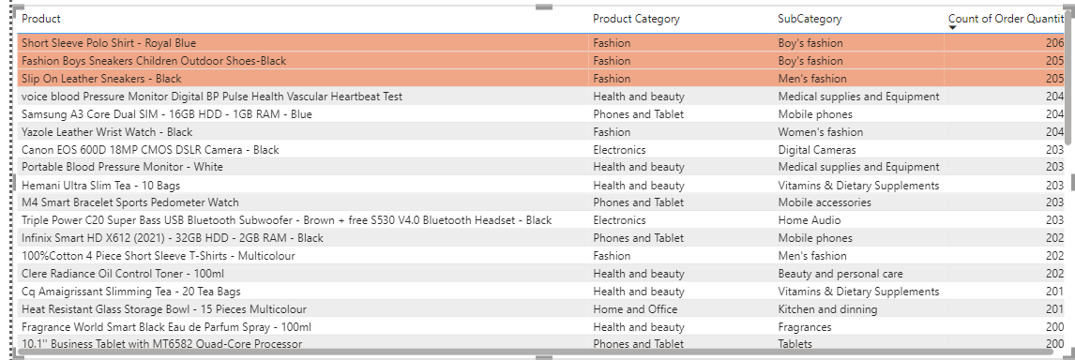
Identifying Popular Products, Categories, and Subcategories
INSIGHTS
Popular Products, Categories, and Subcategories are
products | categories | subcategories
Short sleeve polo shirt-royal blue | fashion | Boys fashion
Fashion boys sneakers children outdoor shoes-black | fashion | Boys fashion
Slip on leather sneakers-black | Fashion | Men’s fashion
The products, categories, and subcategories listed are popular due to their frequent orders. Through analyzing order quantities, I've identified the most sought-after products to prioritize. This approach ensures our attention is directed towards the most in-demand items for comprehensive analysis.

Slide 11
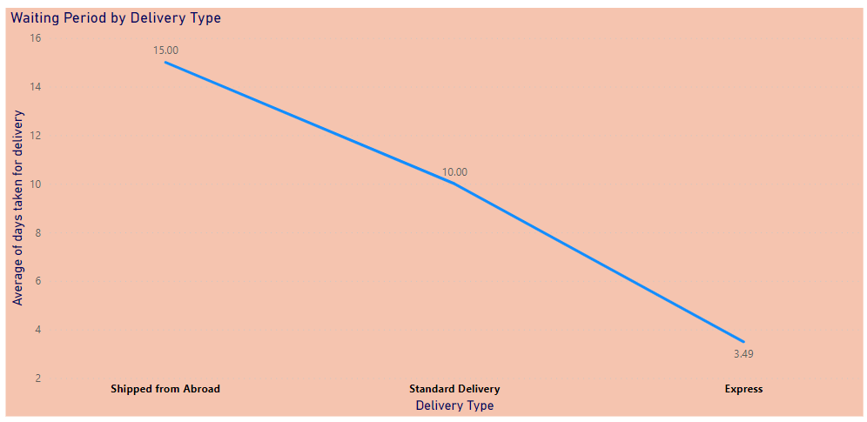
Evaluating the Waiting Period Based on Delivery Type
INSIGHTS
Delivery times differ based on the chosen method:
- Express delivery: 3 days on average
- Standard delivery: 10 days on average
- Deliveries from abroad: 15 days on average
Understanding these variations is crucial for managing customer expectations and optimizing delivery processes.

Slide 12
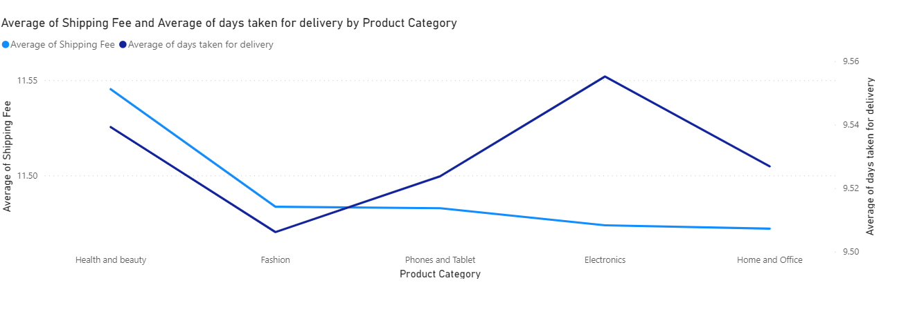
Analyzing the Relationship Between Shipping Fees and Product Categories
INSIGHTS
Health and beauty products incur the highest shipping fees, followed by fashion, electronics, and home and office items. Products with higher shipping fees generally have shorter waiting periods, suggesting a correlation between shipping costs and delivery times. This trend underscores the importance of managing customer expectations and optimizing logistical processes. To mitigate the impact of high shipping fees on sales, businesses could offer free or discounted shipping promotions and optimize shipping rates.

Slide 13

Measures to Improve Sales
INSIGHTS
Targeted Discounts: Stimulate demand by offering discounts on low-sales products and maintain competitiveness with discounts on high-priced items.
Tiered Loyalty Program: Introduce tiered loyalty programs with tailored benefits to incentivize customers to move up the loyalty ladder.
Exclusive Deals: Provide tier-specific deals to reward customer loyalty and tailor discounts based on preferences and purchase history.
Priority Support: Enhance the shopping experience with priority customer support for valued members to resolve issues efficiently.
Surprise Rewards: Foster loyalty with occasional rewards like bonus discounts and freebies to create memorable experiences and encourage repeat purchases.
Feedback Mechanism: Gather insights through feedback mechanisms to continuously optimize the loyalty program based on customer preferences.
Reduce Waiting Time: Improve customer satisfaction by focusing on reducing waiting times, particularly for products shipped from abroad.

Slide 14
reports

Slide 15
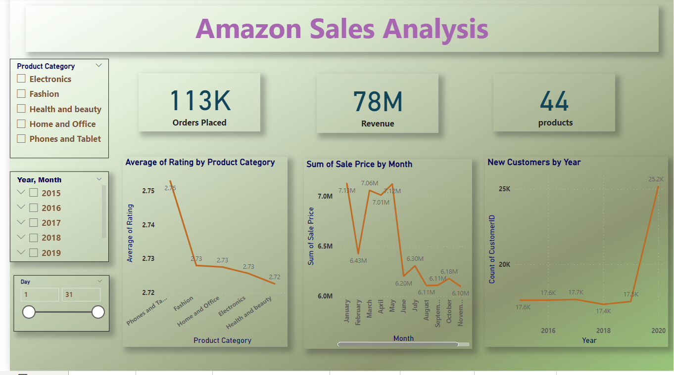
Main tab

Slide 16
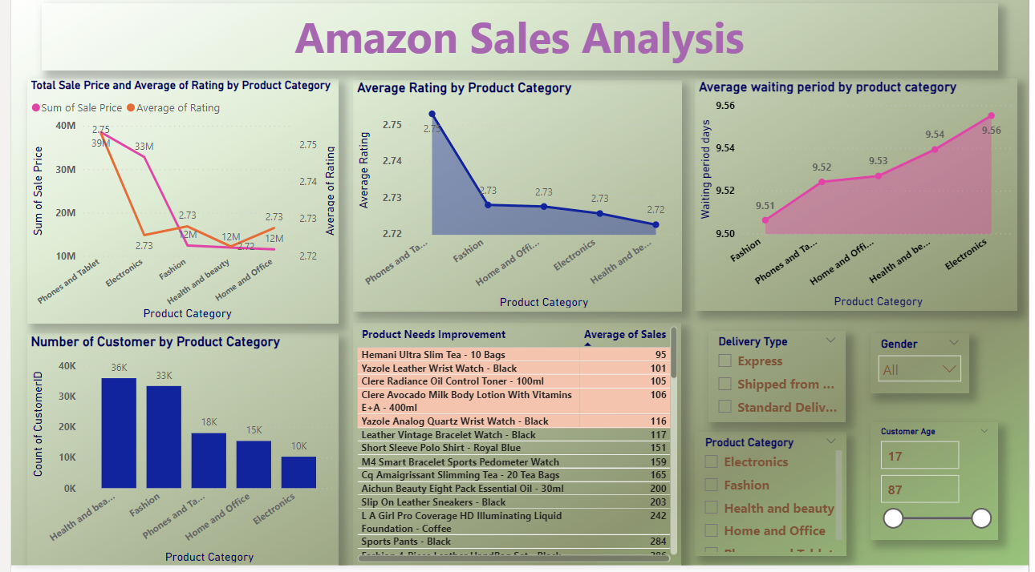
Product tab

Slide 17
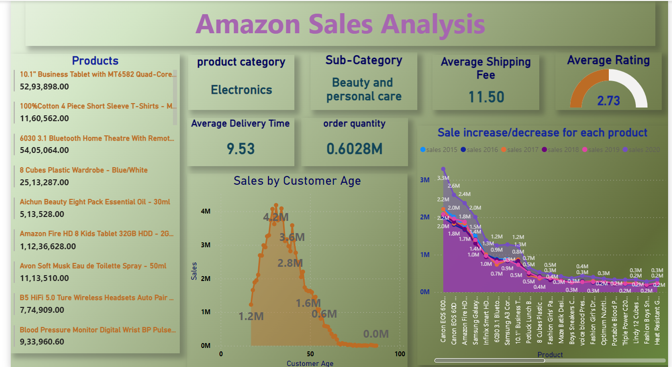
individual Product Tab

Slide 18
conclusion
Amazon's data analysis reveals significant insights that can drive strategic enhancements to maintain its current performance and elevate customer satisfaction. The analysis highlights trends in customer acquisition, product revenue breakdowns, and regional sales distribution. Leveraging this information, Amazon can implement targeted strategies such as offering discounts, introducing loyalty programs, and optimizing delivery times to foster customer loyalty and drive sales. By prioritizing customer needs and continuously refining its approach based on data-driven insights, Amazon is well-positioned to sustain its success and further strengthen its market leadership in the e-commerce industry.

Slide 19
THANK YOU

